Slide 1
The Impact of School Quality on House Prices
Presented by: Nidhi Sehrawat
Imperial College London
(Professional Certificate, Data Analytics)
Nov. 6, 2025

Slide 2
Table of Contents
Executive summary
Introduction
Scope & Focus of Study
Methodology
Results
Conclusion

Slide 3
Executive Summary

Slide 4
Executive Summary
Objective:
This study explores the relationship between school quality and house prices across London boroughs, with a focus on state primary and secondary schools. Using both qualitative and quantitative data, the analysis investigates how educational standards may influence local housing markets and the implications for families, investors and policymakers.
Key Findings:
Positive Correlation Between School Quality and House Prices:
There appears to be a positive relationship between the proportion of Outstanding schools and average house prices.
  Camden: Over 55% of state primary schools are Outstanding; house prices are among the highest in London.
  Richmond upon Thames: Around 45% Outstanding schools with similarly high property values.
  Newham: About 50% Outstanding primary schools but relatively lower house prices, indicating other influencing factors.

Slide 5
Executive Summary
  Kensington & Chelsea: Extremely high house prices and ~50% Outstanding schools — confirming that school quality is one of several contributing drivers.
Conclusion
School quality shows a positive correlation with property values, though the relationship is complex and influenced by multiple socioeconomic factors. Families weigh both education quality and affordability when choosing where to live, highlighting the intertwined nature of education and housing markets in London.

Slide 6
Introduction

Slide 7
Introduction
Background & Context
School quality is widely recognized as a key determinant of residential demand in the UK. Families often prioritize access to high-performing schools, creating price premiums within competitive catchment areas.
This effect is particularly evident in London, where selective schooling options, strong Ofsted oversight, and limited school capacity intensify competition for nearby housing.
Research Questions
This study investigates:
How does school quality influence house prices?
Where is the impact strongest across London boroughs?
What role do state schools play in driving price uplifts?
The aim is to deliver quantified insight into a widely recognized but unevenly measured market relationship between education quality and housing value.

Slide 8
Introduction
Why a Data-Driven Approach
A data-driven methodology provides:
Objective measurement of the “school premium” effect
Insights derived from property transactions, Ofsted ratings, school type, and geography
A predictive foundation for understanding future market behaviour
This approach ensures that findings support evidence-based decision-making for families, investors and policymakers navigating London’s housing market.

Slide 9
SCOPE & Focus of study

Slide 10
SCOPE & FOCUS OF STUDY
The primary focus of this study is to analyze the impact of state school quality on house prices across London boroughs.
The analysis specifically examines state schools and their Ofsted ratings for the year 2025, in relation to average house prices in 2025.
In addition, a temporal analysis of the variation in average house prices across 2015–2025 was conducted to identify long-term trends and fluctuations in the London housing market.
This allows comparison between current (2025) housing conditions and historical price movements, providing deeper context for the observed relationship between education quality and property values.

Slide 11
Methodology

Slide 12
Methodology
Overview
This analysis focuses exclusively on state schools across London boroughs.
A total of 31 boroughs were included in the study. Westminster was excluded due to data inconsistencies.
Data Sources
The study integrates multiple publicly available datasets to explore the relationship between school quality and house prices in London:
HM Land Registry – UK House Price Index (HPI):
Provides property transaction data, including sale prices, property types, transaction dates, and locations. Used to calculate borough-level average house prices from 2015 to 2025.
Source: UK HPI Data – Gov.uk)
Ofsted and Department for Education (DfE):
Contains inspection outcomes and school characteristics for state primary and secondary schools. Each school’s Ofsted rating (“Outstanding”, “Good”, “Requires Improvement”, “Inadequate”) was linked to its borough using postcode data.

Slide 13
Methodology
  Sources:
  Ofsted Inspection Outcomes – Gov.uk
  Get Information About Schools – Gov.uk)
Office for National Statistics (ONS):
Provided borough-level socioeconomic and demographic data (house price index, Ofsted rating).
London Datastore:
Supplied the geospatial boundary shapefiles used for borough-level mapping.
Source: Statistical GIS Boundary Files for London

Slide 14
Methodology
Data Cleaning & Preparation (Python, Jupyter Notebook):
All datasets were cleaned, merged, and standardised using Python (Pandas, NumPy) within Jupyter Notebook to ensure consistency and analytical accuracy.
Key steps included:
Filtering: Only state schools were included; independent schools were excluded.
Exclusions: Westminster was removed due to missing or inconsistent school inspection data.
Matching: School-level data were linked with borough-level house price data using area code and local authority codes.
Aggregation: Calculated the percentage of schools rated “Outstanding” or “Good” in each borough.

Slide 15
Methodology
Validation: Outliers in the house price dataset were identified and removed using statistical thresholds.
Integration: Final datasets were merged by borough and year (2025) for visualization and correlation analysis.
Analytical Approach
A data-driven, exploratory, and comparative approach was adopted to understand the interaction between school performance and housing market trends.
Exploratory Data Analysis (EDA):
Conducted using Python to visualise distributions and relationships, and to identify borough-level variations in both school ratings and house prices.

Slide 16
Methodology
Validation: Outliers in the house price dataset were identified and removed using statistical thresholds.
Integration: Final datasets were merged by borough and year (2025) for visualization and correlation analysis.
Analytical Approach
A data-driven, exploratory, and comparative approach was adopted to understand the interaction between school performance and housing market trends.
Exploratory Data Analysis (EDA):
Conducted using Python to visualise distributions and relationships, and to identify borough-level variations in both school ratings and house prices.

Slide 17
Methodology
Comparative Analysis:
Evaluated differences across 31 London boroughs, focusing on:
  The proportion of schools rated “Outstanding” or “Good”.
  Corresponding house price averages (2025).
  Variations between primary and secondary school performance.
Correlation Analysis:
Applied Pearson’s correlation coefficient to measure the relationship between school quality (% Outstanding/Good schools) and borough-level average house prices.

Slide 18
Methodology
Visual Analytics in Tableau:
Multiple visualization types were created to uncover spatial and temporal insights:
  Bar Charts: Compared boroughs by the number of schools in each Ofsted category.
  Heat Maps: Highlighted variation in housing prices from 2015-2025.
  Dual-Axis Charts: Displayed both average house prices and % Outstanding Primary and Secondary schools across the 31 London boroughs to identify parallel trends.

Slide 19
Results

Slide 20
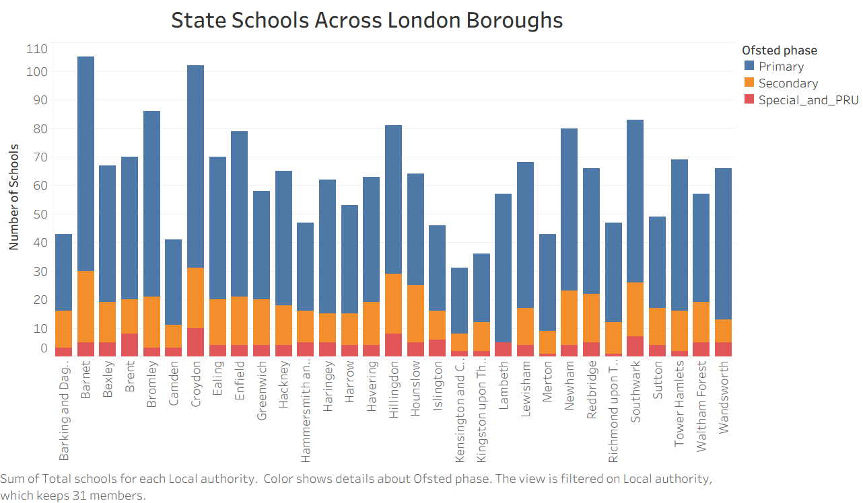
Number of State Schools

Slide 21
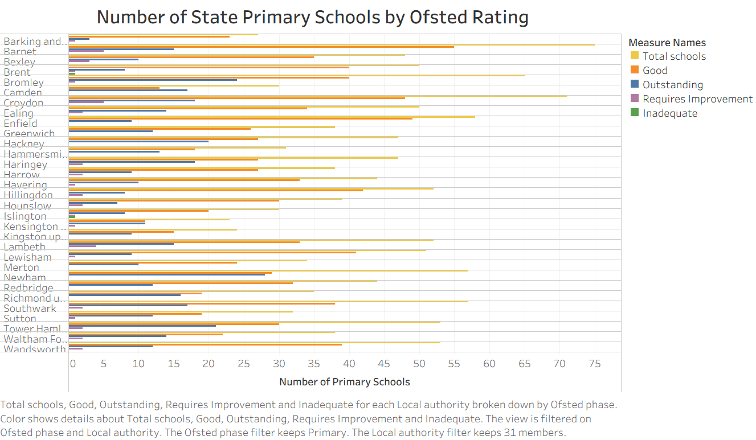
State PRIMARY Schools BY OFSTED RATING

Slide 22
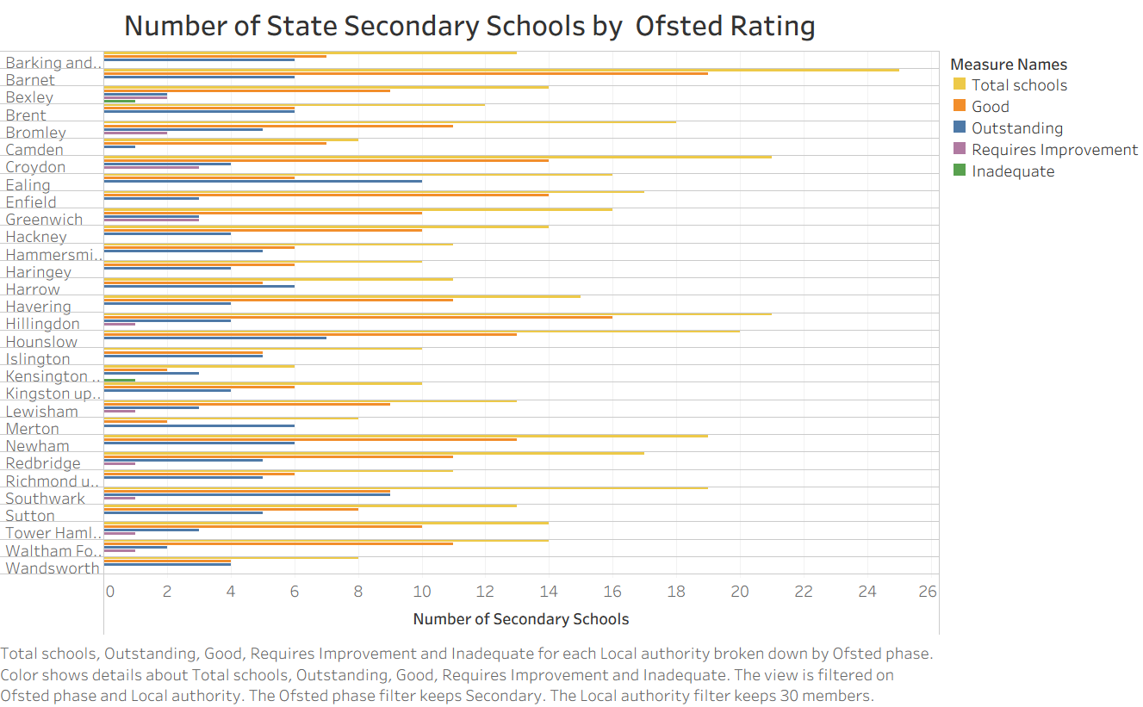
State SECONDARY Schools BY OFSTED RATING

Slide 23
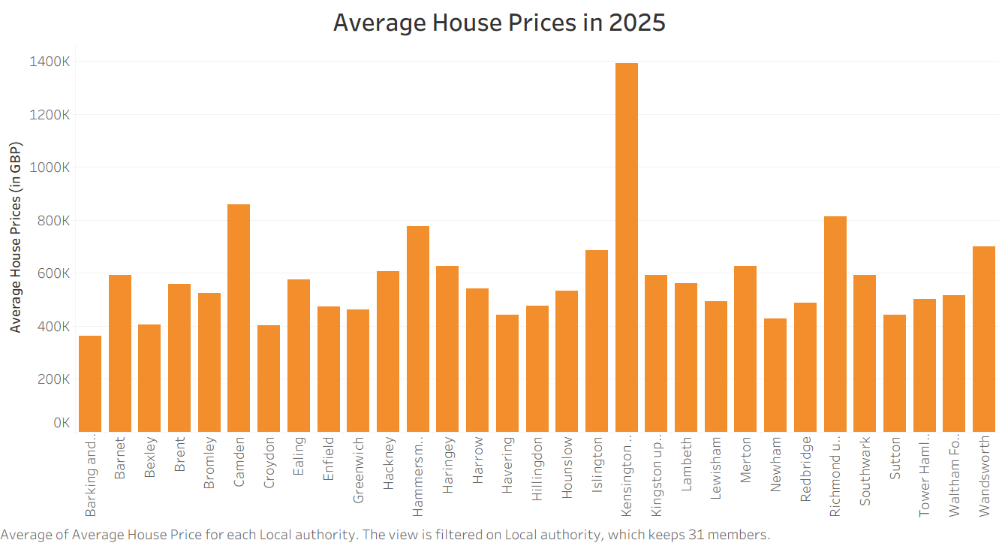
AVERAGE HOUSE PRICES IN 2025

Slide 24
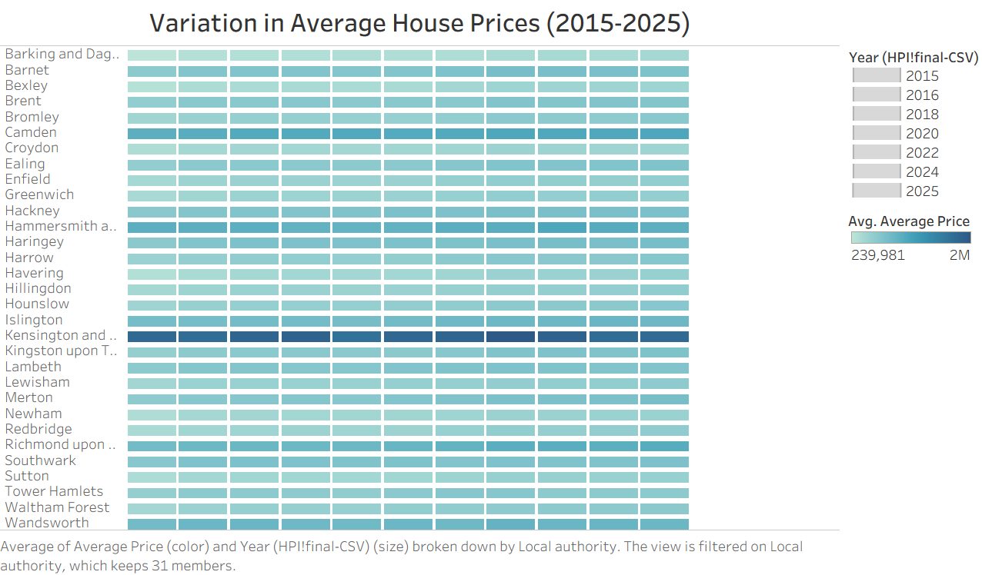
VARIATION IN AVERAGE HOUSE PRICES (2015-2025)

Slide 25
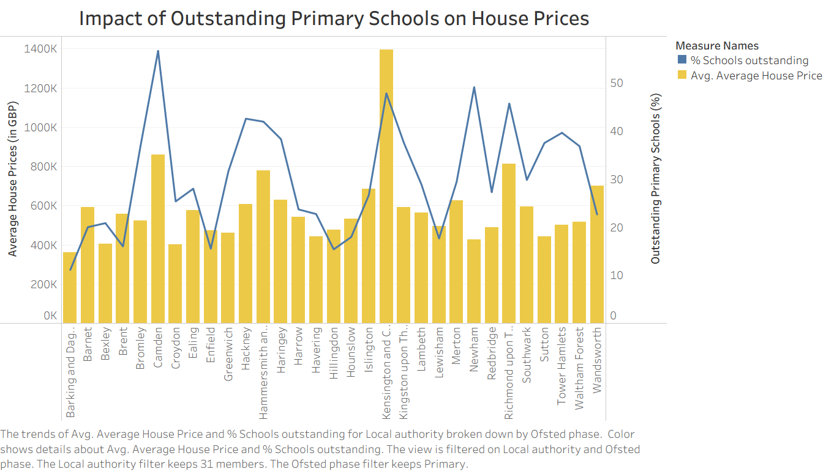
IMPACT OF School QUALITY ON HOUSE PRICES (2025)

Slide 26
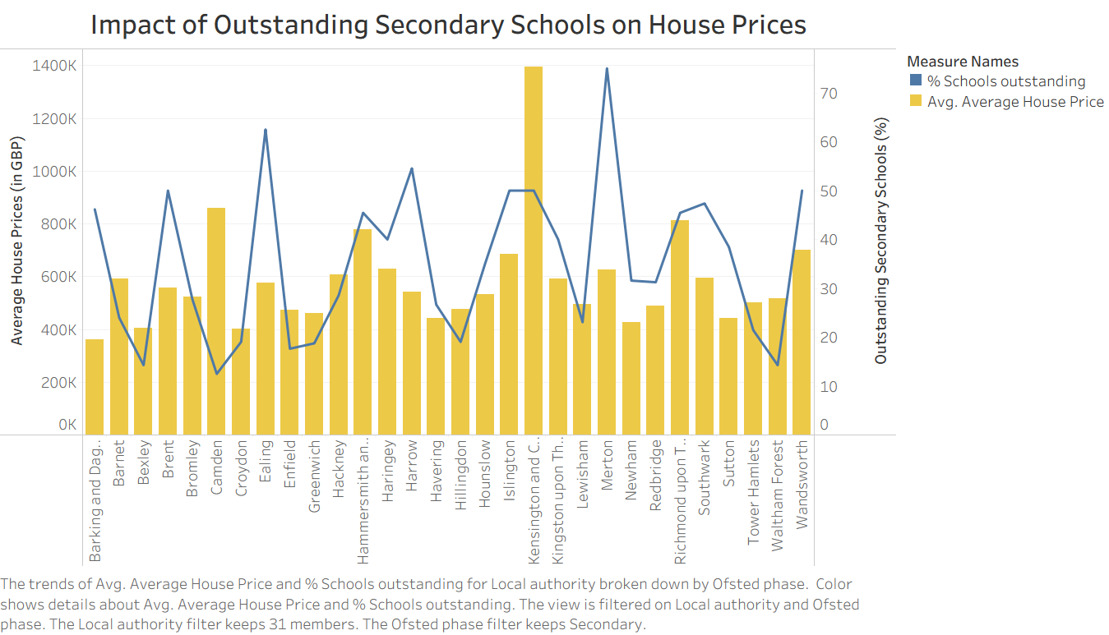
IMPACT OF School QUALITY ON HOUSE PRICES (2025)

Slide 27
RESULTS
Positive Correlation Between School Quality and House Prices:
  There appears to be a positive relationship between the proportion of Outstanding schools and average house prices.
  Camden: Over 55% of state primary schools are Outstanding; house prices are among the highest in London.
  Richmond upon Thames: Around 45% Outstanding schools with similarly high property values.
  Newham: About 50% Outstanding primary schools but relatively lower house prices, indicating other influencing factors.

Slide 28
RESULTS
  Kensington & Chelsea: Extremely high house prices and ~50% Outstanding schools — confirming that school quality is one of several contributing drivers.
Trends in Average House Prices (2015–2025):
House prices have generally increased over the last decade, with a sharp rise in 2022 (post–COVID-19) followed by a slight decline and stabilization in subsequent years.

Slide 29
RESULTS
Variation Between Primary and Secondary School Quality:
  Some boroughs show high proportions of Outstanding primaries but low proportions of Outstanding secondaries.
  Camden and Merton: Around 60% of state primaries are Outstanding, while only about 12% of secondaries reach the same rating.
Number of State Schools:
  Barnet has the highest number of state schools, followed by Croydon.
  Most boroughs have more Good state primaries than Outstanding ones.
  Merton, Ealing, and Harrow have relatively higher proportions of Outstanding state secondary schools.

Slide 30
Conclusion

Slide 31
CONCLUSION
This study explored the relationship between state school quality and house prices across London boroughs, combining data-driven analysis, statistical methods, and visual insights from Tableau.
Findings indicate that boroughs with a higher proportion of Outstanding or Good state schools tend to exhibit higher average house prices, though the relationship is not uniform across all areas. Boroughs such as Camden and Richmond upon Thames demonstrate both strong school performance and elevated property values, whereas areas like Newham reveal that other socioeconomic factors also influence affordability and demand.
The temporal analysis (2015–2025) shows a consistent upward trend in average house prices, with a sharp rise post–COVID-19 in 2022 followed by a stabilisation phase. This suggests that, while school quality remains a key driver, broader economic, demographic, and policy factors also shape London’s housing market.

Slide 32
CONCLUSION
Overall, the analysis highlights that educational quality contributes to the spatial inequality of property values within London — reinforcing the notion of a “school quality premium.”
Future research could extend this study by incorporating private and grammar schools, commuting accessibility, and income distribution to better understand the multi-dimensional nature of housing demand in urban contexts.

Slide 33
THANK YOU
Nidhi Sehrawat
Professional Certificate in Data Analytics
Imperial College of London

